Slide 1
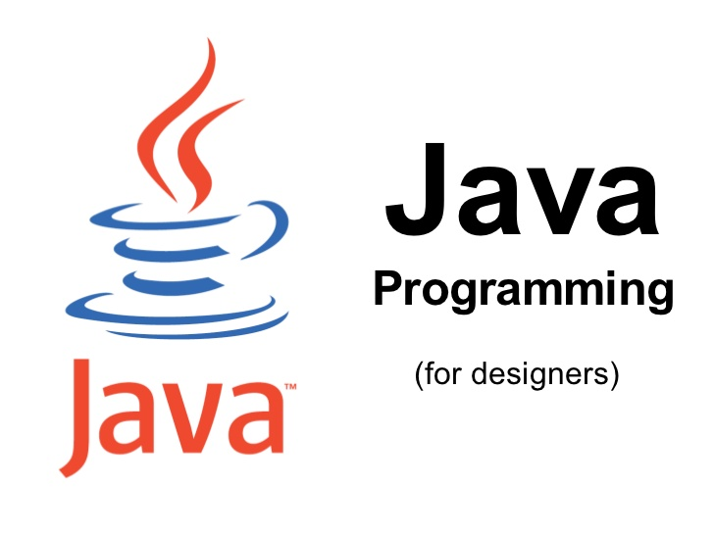

Slide 2

1.8 version

Slide 3
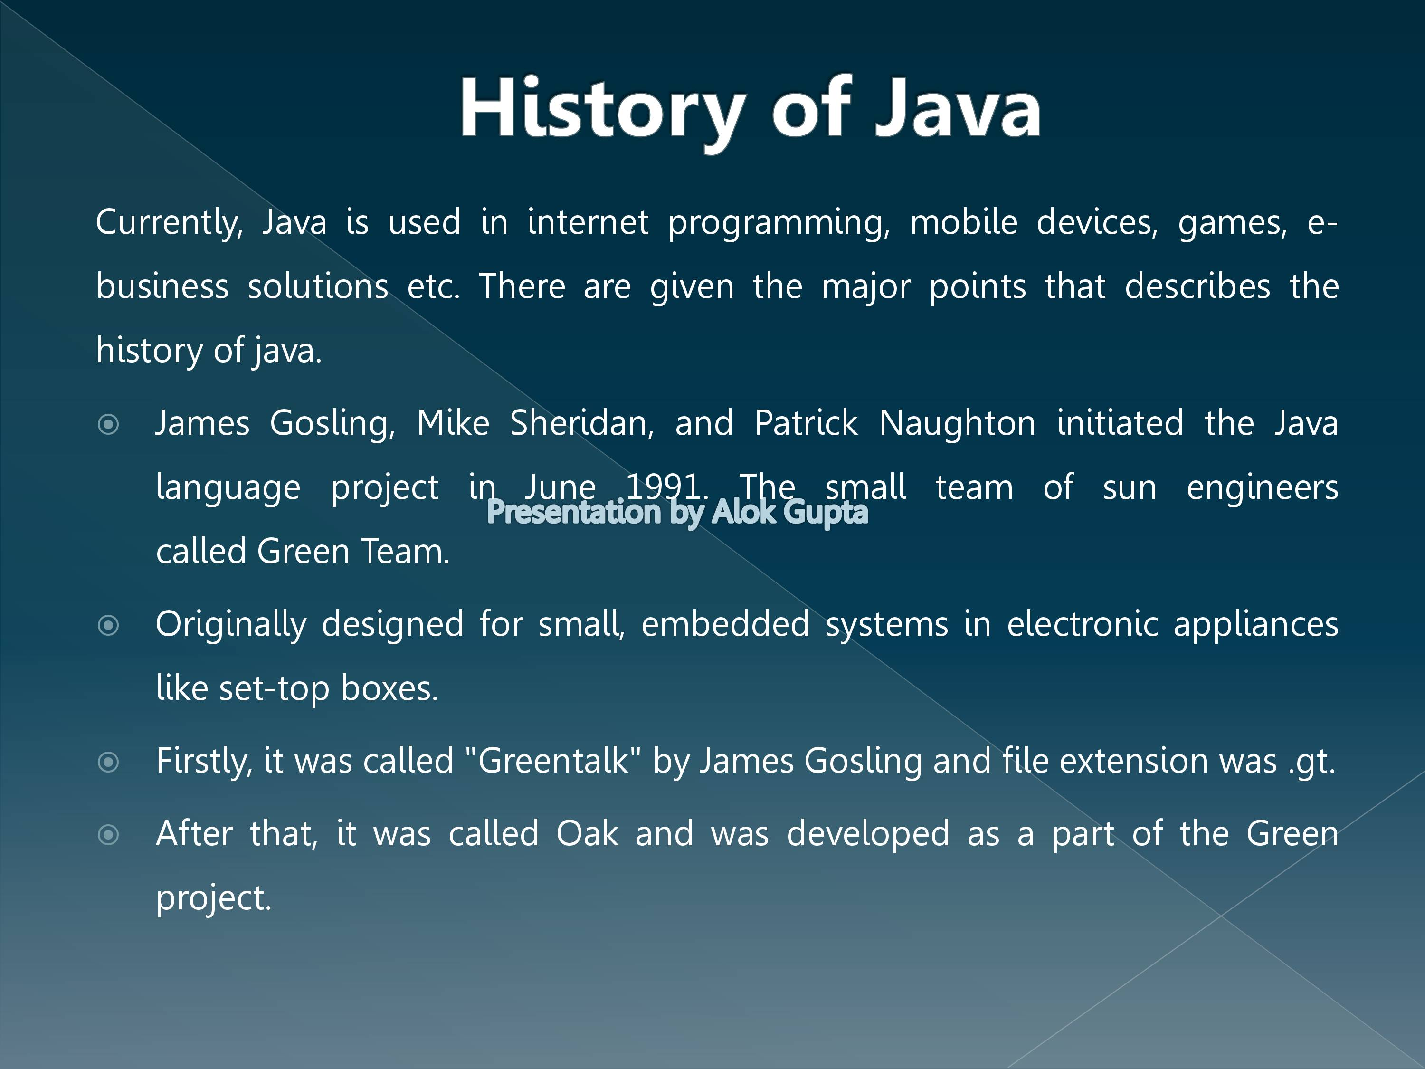

Slide 4
Oak was renamed Java in 1994 after a trademark search revealed that Oak was used by Oak Technology. Java 1.0 was finally shipped in 1996.
OOP languages are:
Significant object-oriented languages include: (list order based on TIOBE index) Java, C++, C#, Python, R, PHP, Visual Basic.NET, JavaScript, Ruby, Perl, Object Pascal, Objective-C, Dart, Swift, Scala, Kotlin, Common Lisp, MATLAB, and Smalltalk.

Slide 5
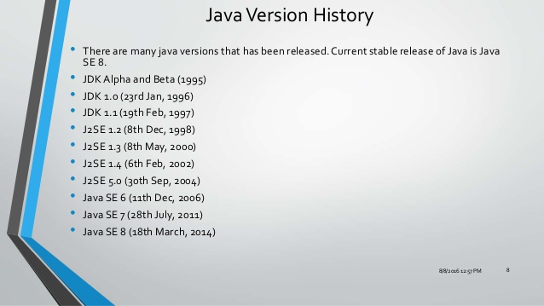

Slide 6
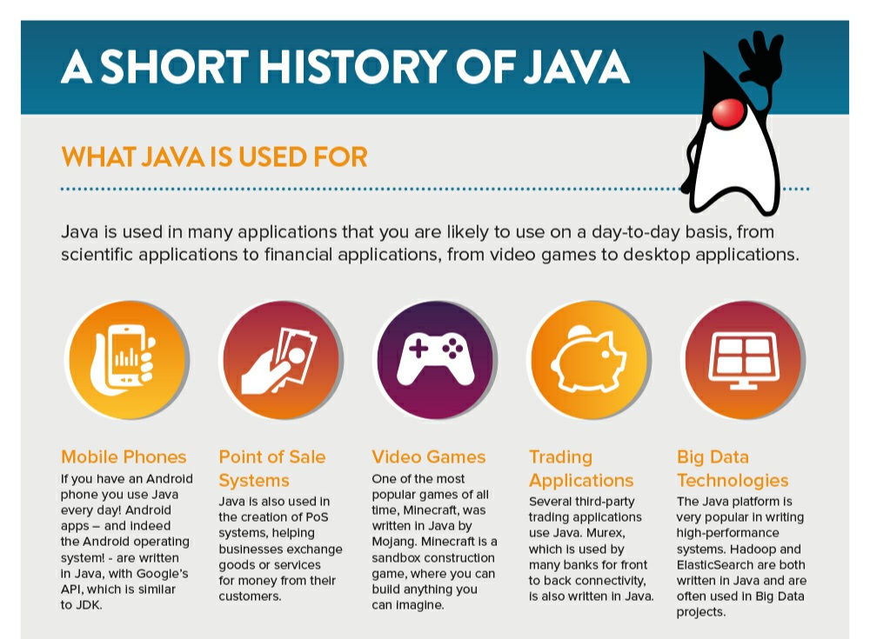

Slide 7
Evaluation of JAVA
The development of each programming language is based on a fact: there is a need to solve a problem that was not resolved by previous programming languages. Early programmers had to choose different programming languages, usually for various tasks, such as a specific language for a type of field.

Slide 8
C is a processor-oriented programming language; it is easy to execute and understand. C became quite famous at that time because it was reliable, simple and easy to use.
Though C was a quite efficient and successful programming language, the complexity of the program was seeking more efficient language to solve problems.

Slide 9
C++ came with object-oriented programming features. C++ is the extension of C language which has been used extensively. It is a powerful modern language that includes the power and simplicity of C and the characteristics of OOP. C++ provides more functional software benefits than C.

Slide 10
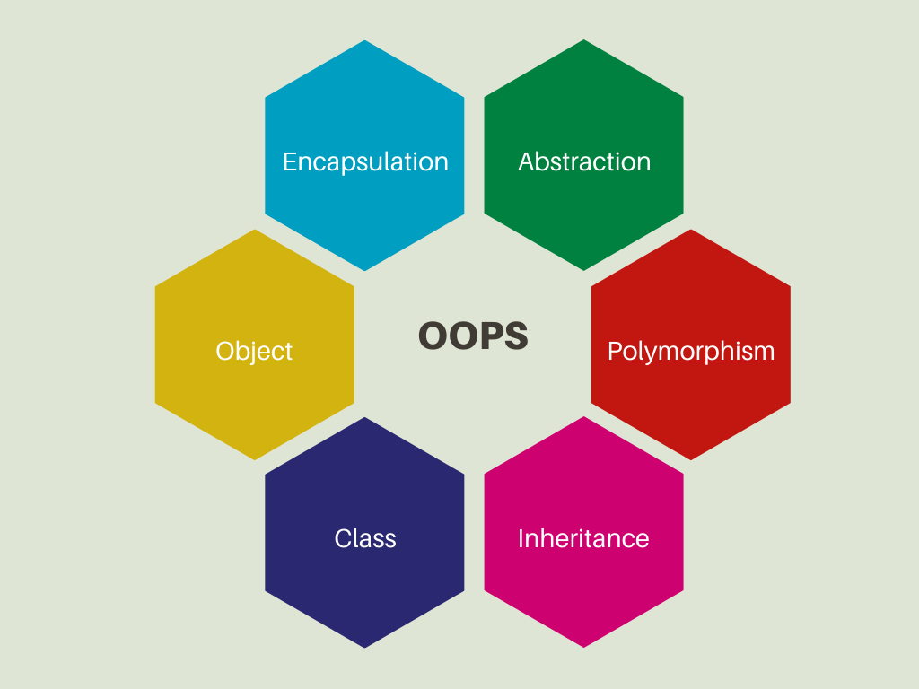

Slide 11
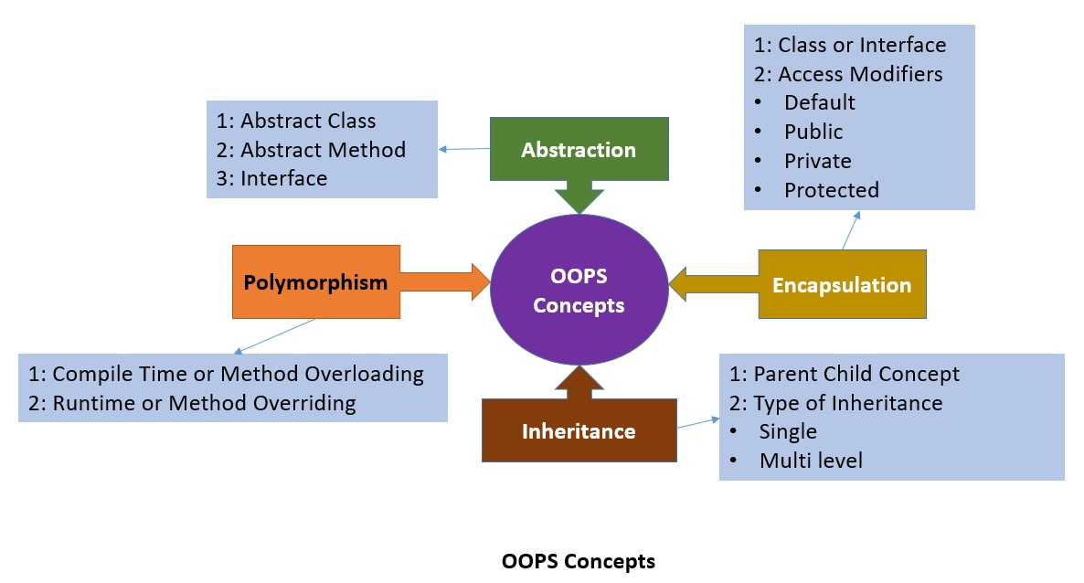

Slide 12
Programming Language
Java is a class-based, object-oriented programming language that is designed to have as few implementation dependencies as possible. ... Java applications are typically compiled to bytecode that can run on any Java virtual machine (JVM) regardless of the underlying computer architecture.

Slide 13
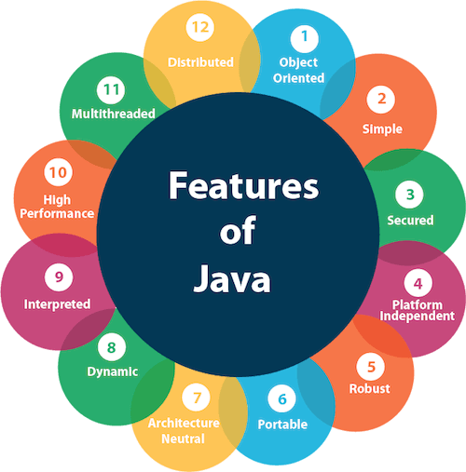

Slide 14
Object Oriented − In Java, everything is an Object. Java can be easily extended since it is based on the Object model.
Platform Independent − Unlike many other programming languages including C and C++, when Java is compiled, it is not compiled into platform specific machine, rather into platform independent byte code. This byte code is distributed over the web and interpreted by the Virtual Machine (JVM) on whichever platform it is being run on.

Slide 15
Simple − Java is designed to be easy to learn. If you understand the basic concept of OOP Java, it would be easy to master.
Secure − With Java's secure feature it enables to develop virus-free, tamper-free systems. Authentication techniques are based on public-key encryption.
Architecture-neutral − Java compiler generates an architecture-neutral object file format, which makes the compiled code executable on many processors, with the presence of Java runtime system

Slide 16
Portable − Being architecture-neutral and having no implementation dependent aspects of the specification makes Java portable. Compiler in Java is written in ANSI C with a clean portability boundary, which is a POSIX subset.
Robust − Java makes an effort to eliminate error prone situations by emphasizing mainly on compile time error checking and runtime checking.
Multithreaded − With Java's multithreaded feature it is possible to write programs that can perform many tasks simultaneously. This design feature allows the developers to construct interactive applications that can run smoothly.

Slide 17
Interpreted − Java byte code is translated on the fly to native machine instructions and is not stored anywhere. The development process is more rapid and analytical since the linking is an incremental and light-weight process.
High Performance − With the use of Just-In-Time compilers, Java enables high performance.
Distributed − Java is designed for the distributed environment of the internet.
Dynamic − Java is considered to be more dynamic than C or C++ since it is designed to adapt to an evolving environment. Java programs can carry extensive amount of run-time information that can be used to verify and resolve accesses to objects on run-time.

Slide 18
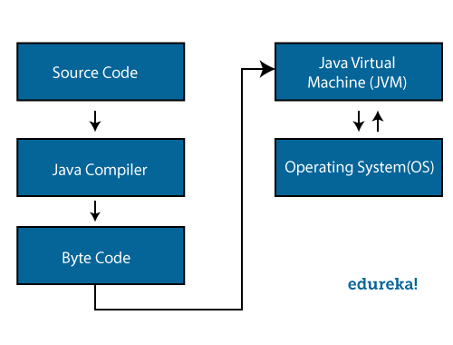
Java Architecture

Slide 19
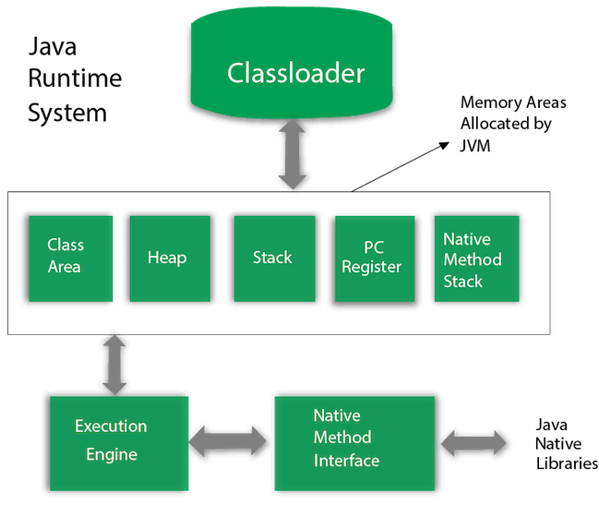

Slide 20
Java Virtual Machine
A Java virtual machine (JVM) is a virtual machine that enables a computer to run Java programs as well as programs written in other languages that are also compiled to Java bytecode. The JVM is detailed by a specification that formally describes what is required in a JVM implementation

Slide 21
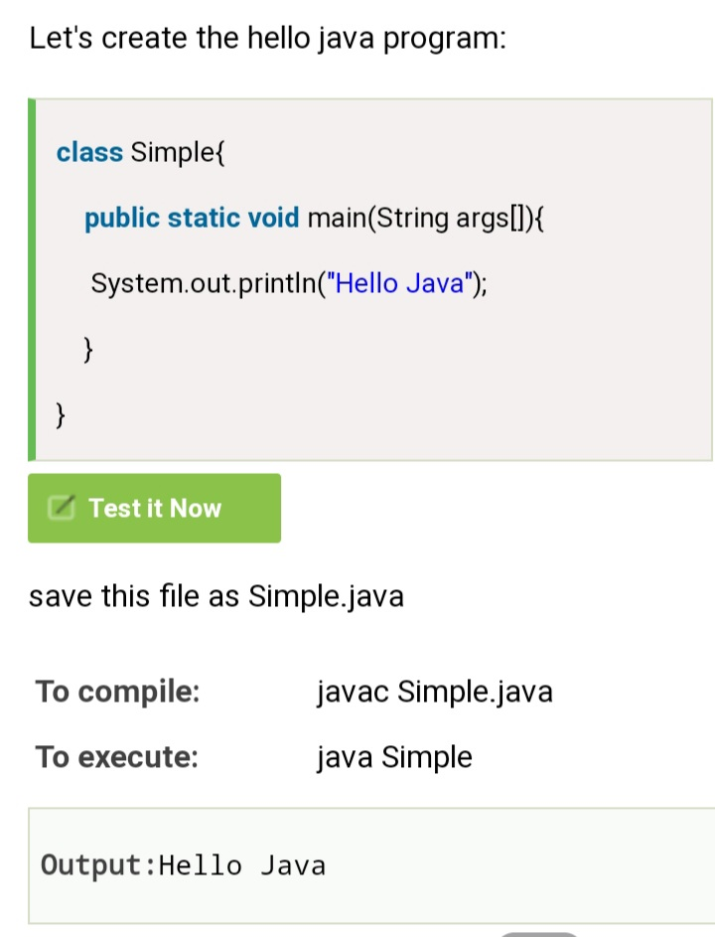

Slide 22
public class FirstProgram {
public static void main(String args[]) {
System.out.println("HI");
}
}
OUTPUT:
HI

Slide 23
pseudo code for program:
Defining a Sample Point Class
created a class point x and y
start the execution - main a b
assigning some values x and y
retriving those value assigng to a and b
displaying it.
Syntax for if else:
if(a>b){
max=a;
}
else{max =b;}
max = (a>b)?a:b;

Slide 24
public class Point {
int X;
int Y;
void setX(int x) {
X= (x > 79 ? 79 : (x < 0 ? 0 : x));
}
void setY(int y) {
Y = (y > 24 ? 24 : (y < 0 ? 0 : y));
}
int getX() {
return X;
}
int getY() {
return Y;
}

Slide 25
public static void main(String args[]) {
int a,b;
Point p1 = new Point();
p1.setX(-2);
p1.setY(44);
System.out.println("p1.getX() "+ p1.getX());
a = p1.getX();
System.out.println("The value of a is"+a);
b = p1.getY();
System.out.println("The value of b is"+b);
}
}

Slide 26
public class TestVariable {
int x;
void setx(int x){
x=x;
}
int getx(){
return x;
}
public static void main(String[] args) {
// TODO Auto-generated method stub
TestVariable t1 = new TestVariable();
t1.setx(3);
System.out.println(t1.getx());
}
}

Slide 27
CONSTRUCTOR
A constructor function has the same name as the class name
A class contain more than one constructor
Facilitates multiple ways of initializing an object
Constructor therefore can be overloading

